Slide 1
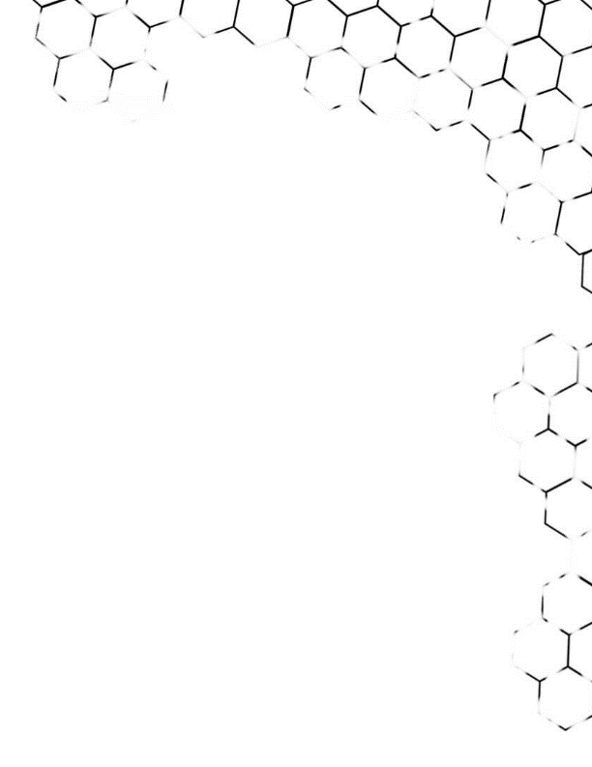

BIG DATA ANALYSIS
TA class I
TA : Lee Chi-Hsuan

Slide 2
Before starting…

Slide 3
Outline
Anaconda & Jupyter notebook
Python Quick Review
Matplotlib

Slide 4
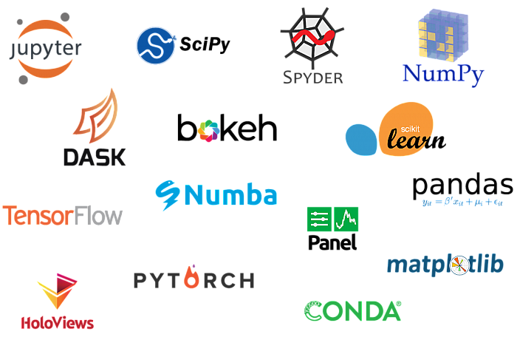

Anaconda
．Data science toolkit
．Tons of packages

Slide 5
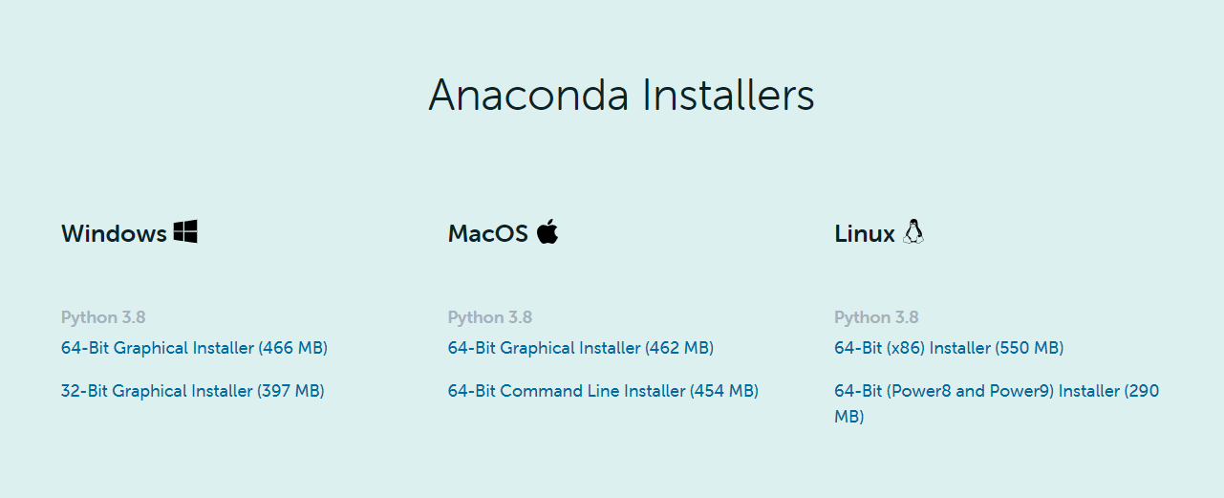

．Download and Install…

Slide 6
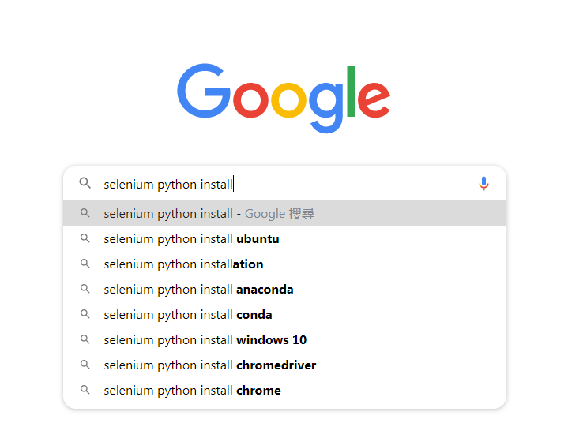
．Packages…

Slide 7
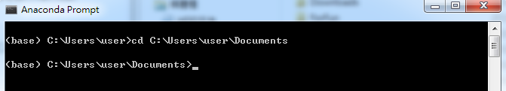
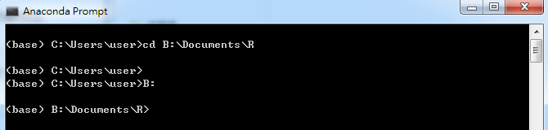
．Changing directory
Same parent
Different parent

Slide 8
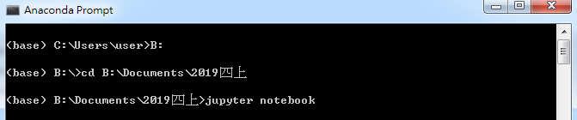
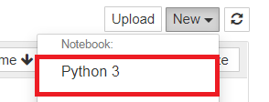
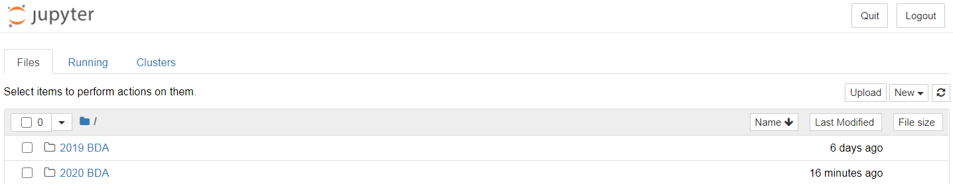
Jupyter Notebook
．Starting the Notebook

Slide 9
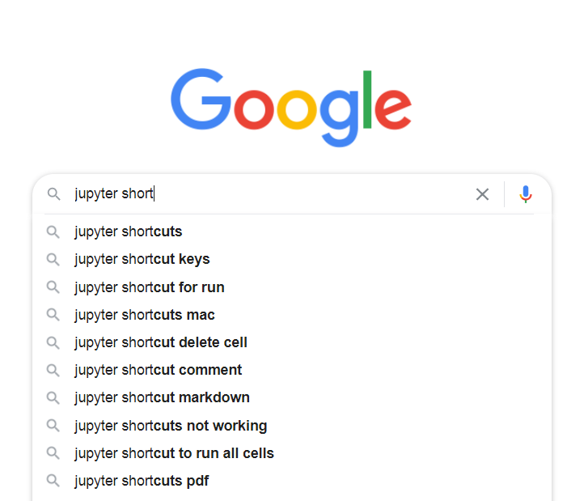
（shift + Enter or Ctrl + Enter）
．Run your code block-wise
．Tab for auto-fill
．Ctrl + / for comment out multiple lines
．Shift + Tab for tooltips
And more…

Slide 10

Python Quick Review
Beautiful is better than ugly.
Explicit is better than implicit.
Simple is better than complex.
Complex is better than complicated.
Flat is better than nested.
Sparse is better than dense.

Slide 11
Readability counts.
Special cases aren't special enough to break the rules.
Although practicality beats purity.
Errors should never pass silently.
Unless explicitly silenced.
In the face of ambiguity, refuse the temptation to guess.
There should be one -- and preferably only one
-- obvious way to do it.
Although that way may not be obvious at first unless you're Dutch.

Slide 12
Now is better than never.
Although never is often better than *right* now.
If the implementation is hard to explain, it's a bad idea.
If the implementation is easy to explain, it may be a good idea.
Namespaces are one honking great idea -- let's do more of those!
－The Zen of Python, by Tim Peters

Slide 13

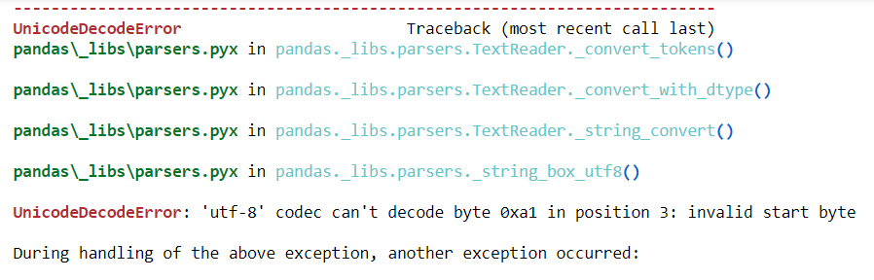
Wut… Error again ?!!

Slide 14
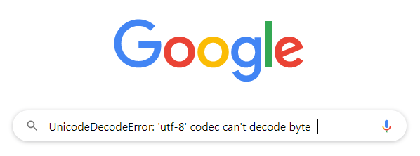
You definitely are not the first person to encounter this kind of problem.

Slide 15
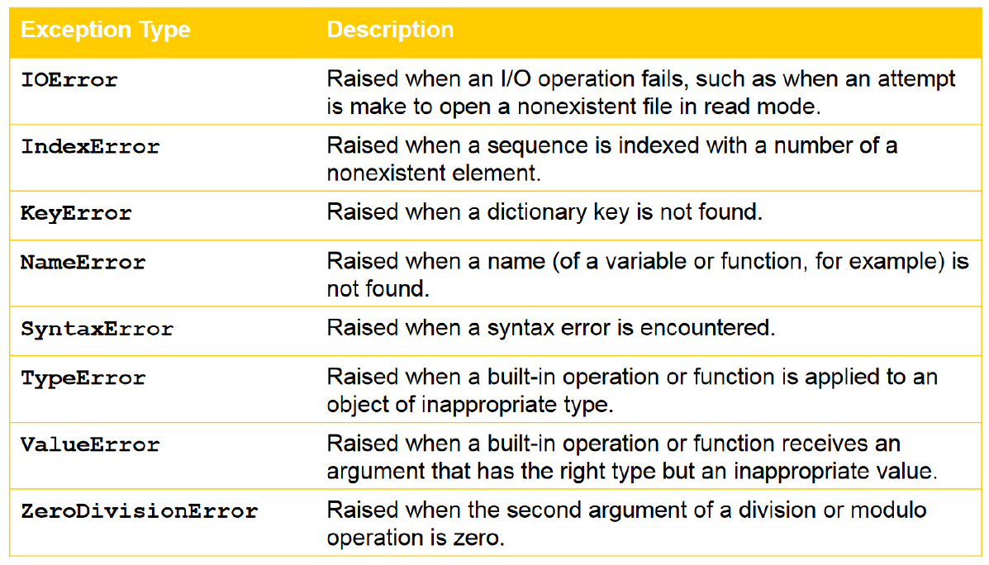

Slide 16
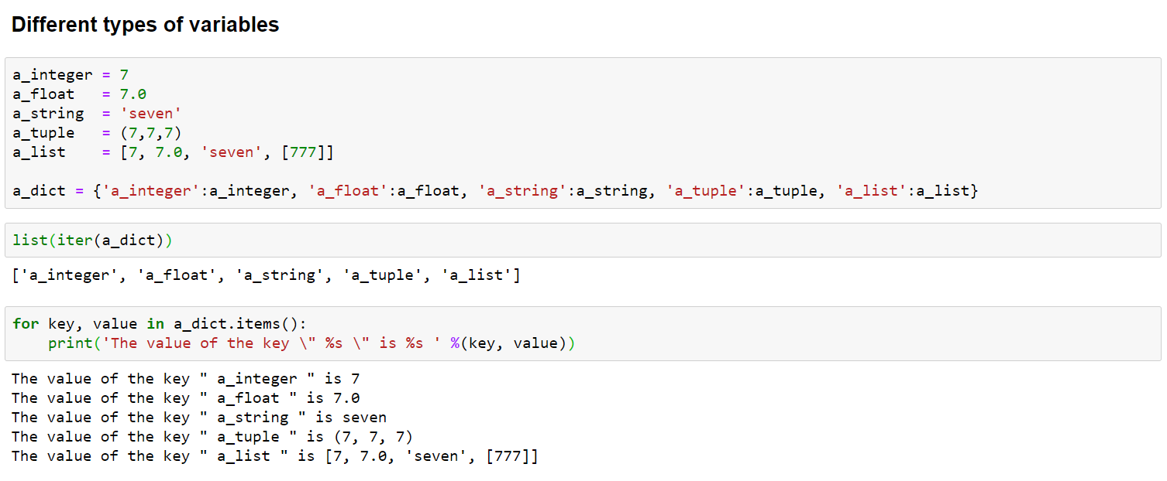
Different types of variables

Slide 17
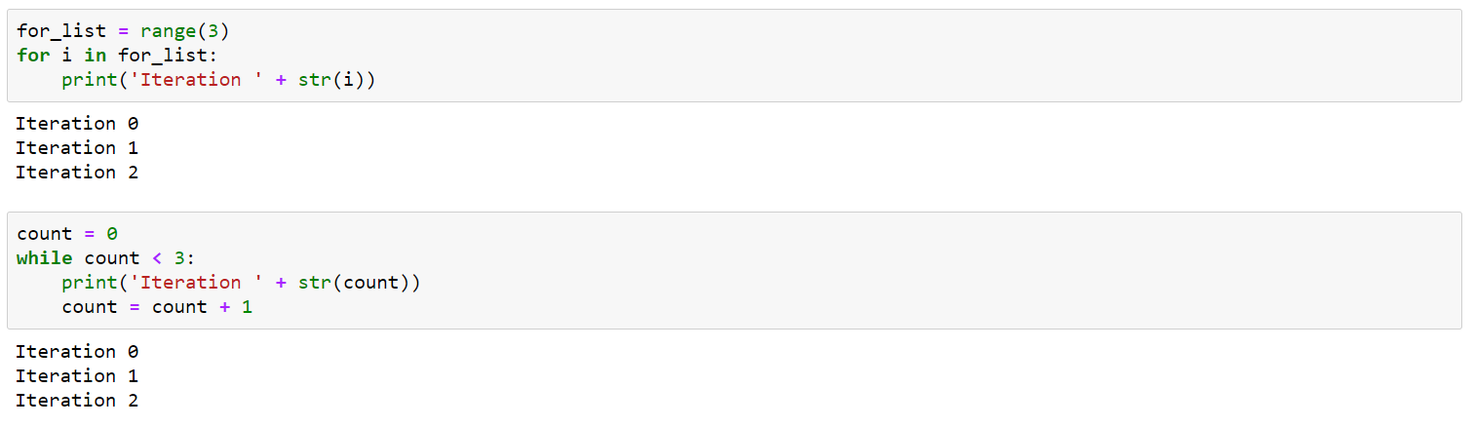
for / while / if else / def()

Slide 18
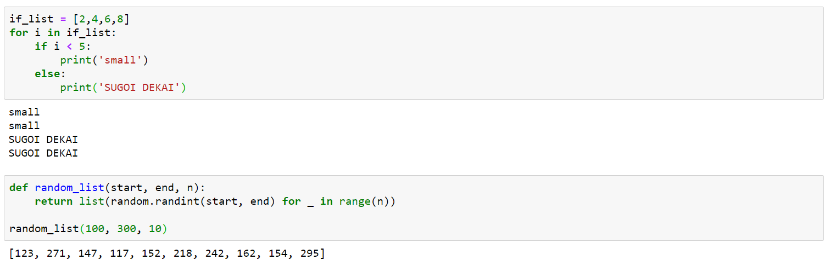

Slide 19
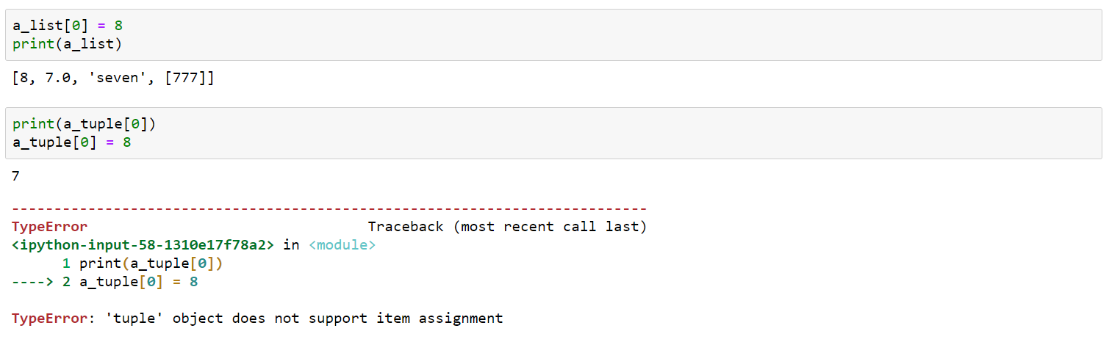
mutable vs. immutable

Slide 20
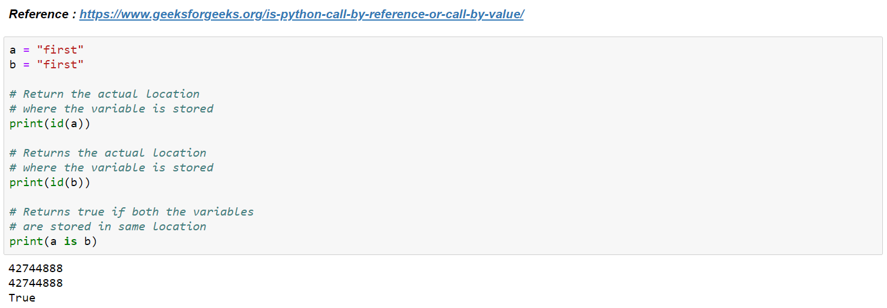
Address - Binding Names to Objects

Slide 21
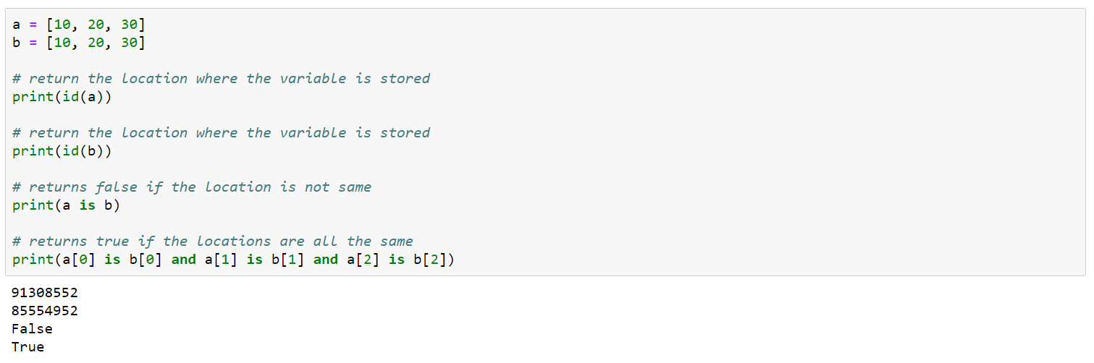

Slide 22
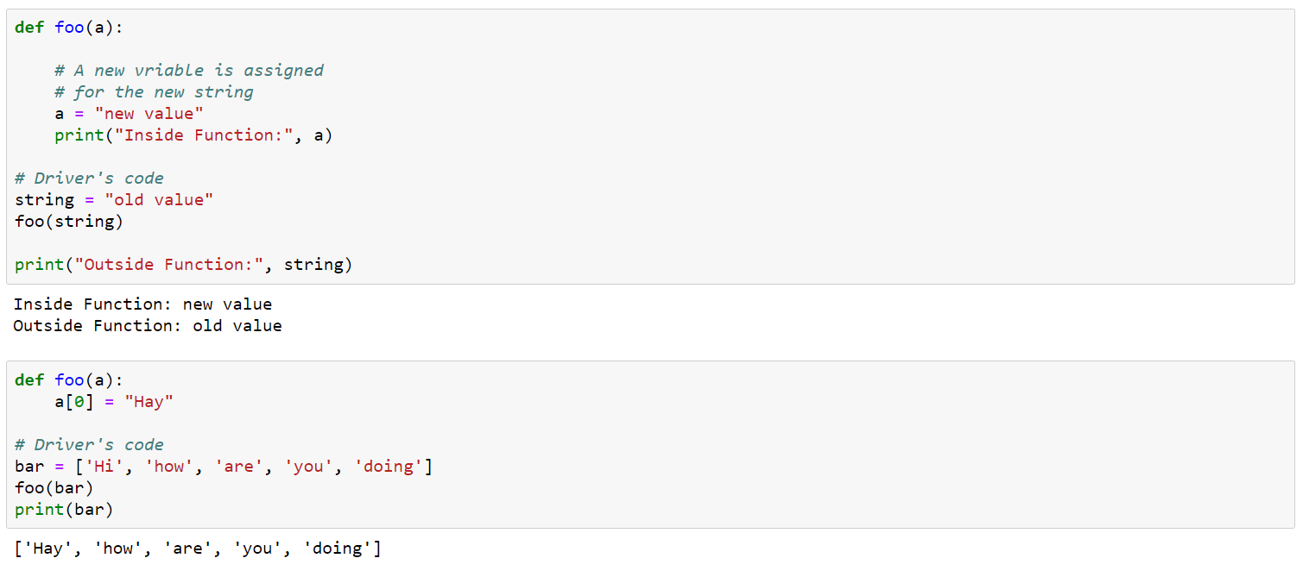
Call by assignment

Slide 23
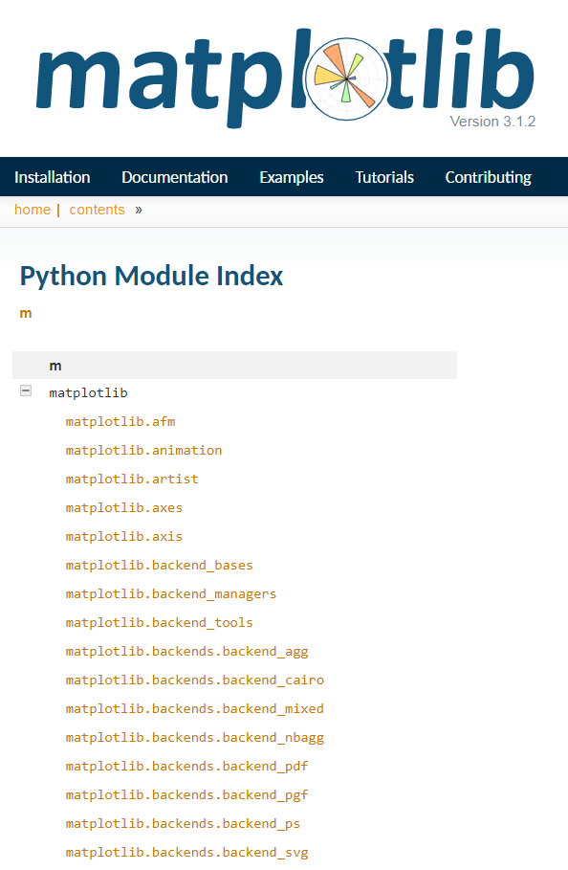
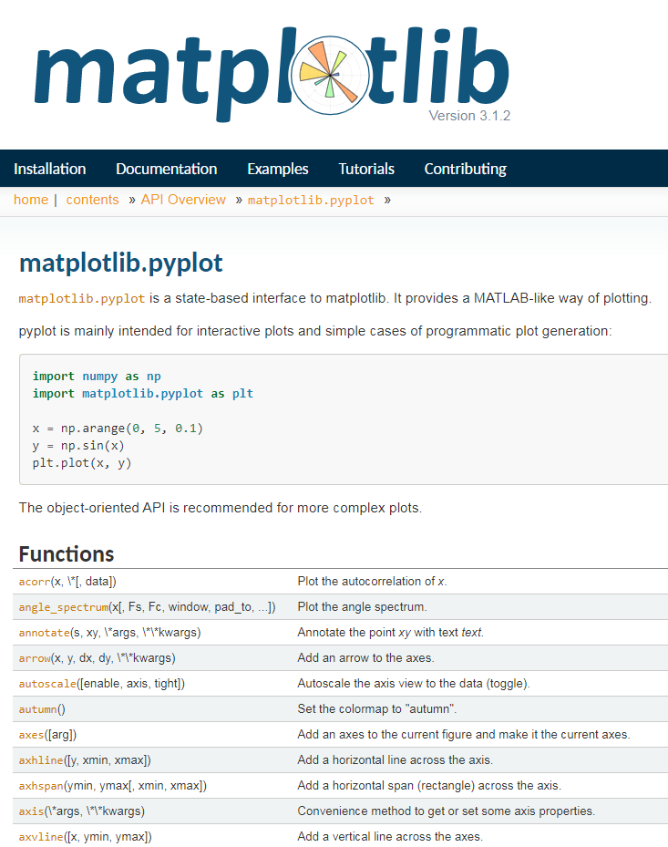
matplotlib
Check out what parameters should be put in each functions

Slide 24
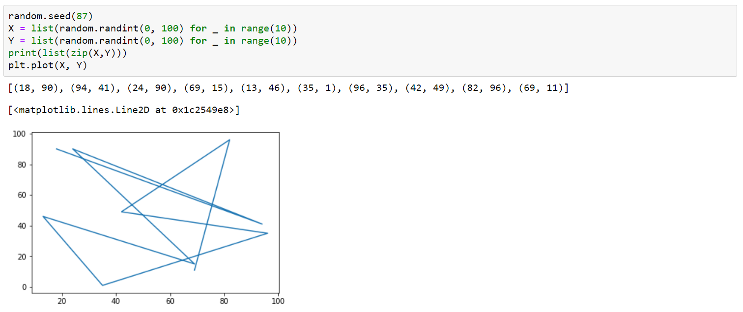
Some examples
You can either plot a list directly or assign some specific X's and Y's.

Slide 25
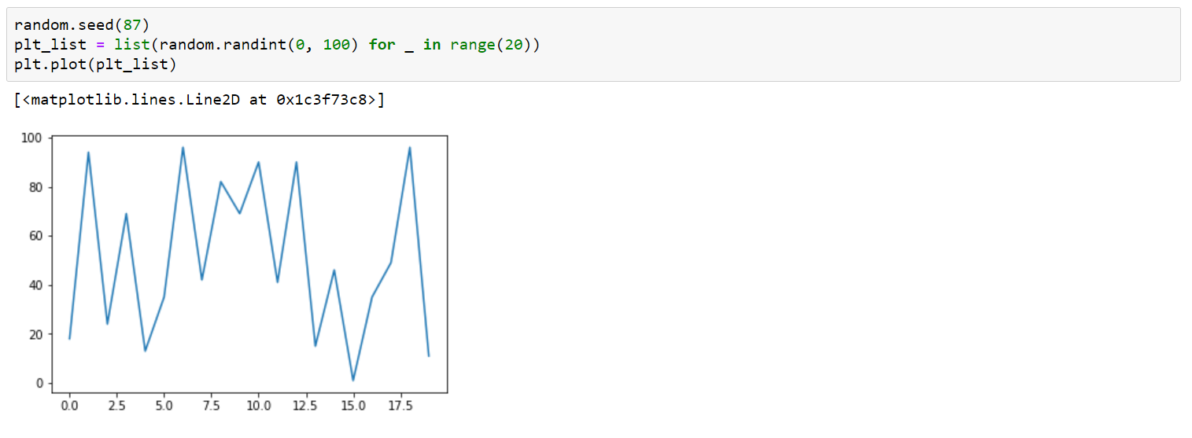
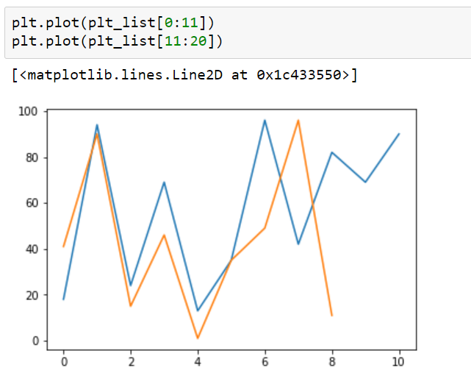
You can slice the list and plot it.

Slide 26
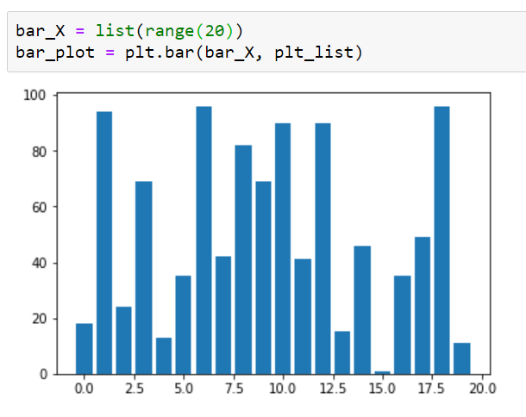
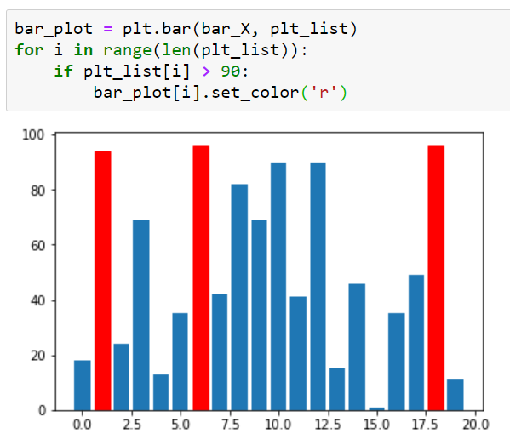
Bar plot
Customize

Slide 27
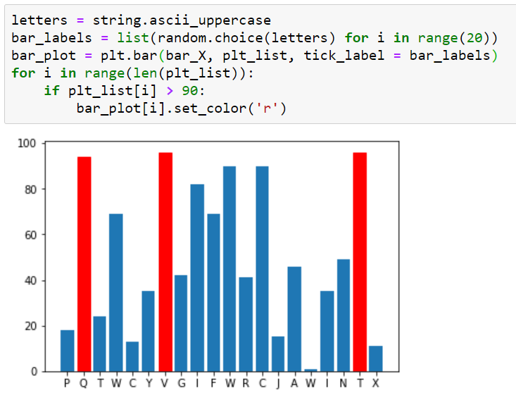
Setting X tick labels

Slide 28
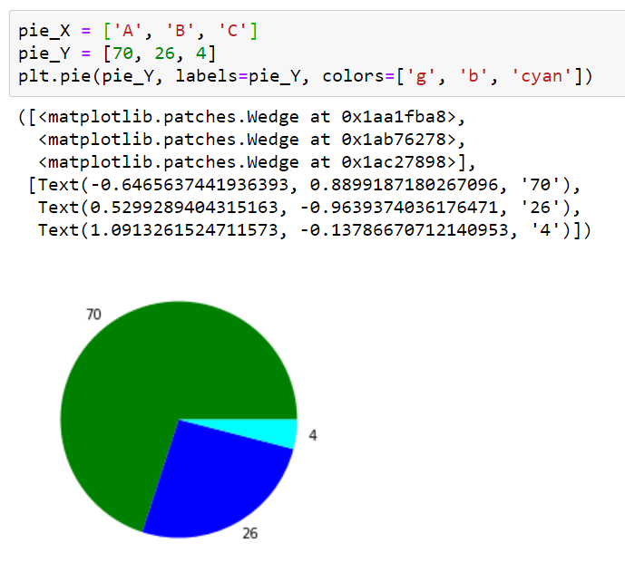
Pie chart

Slide 29
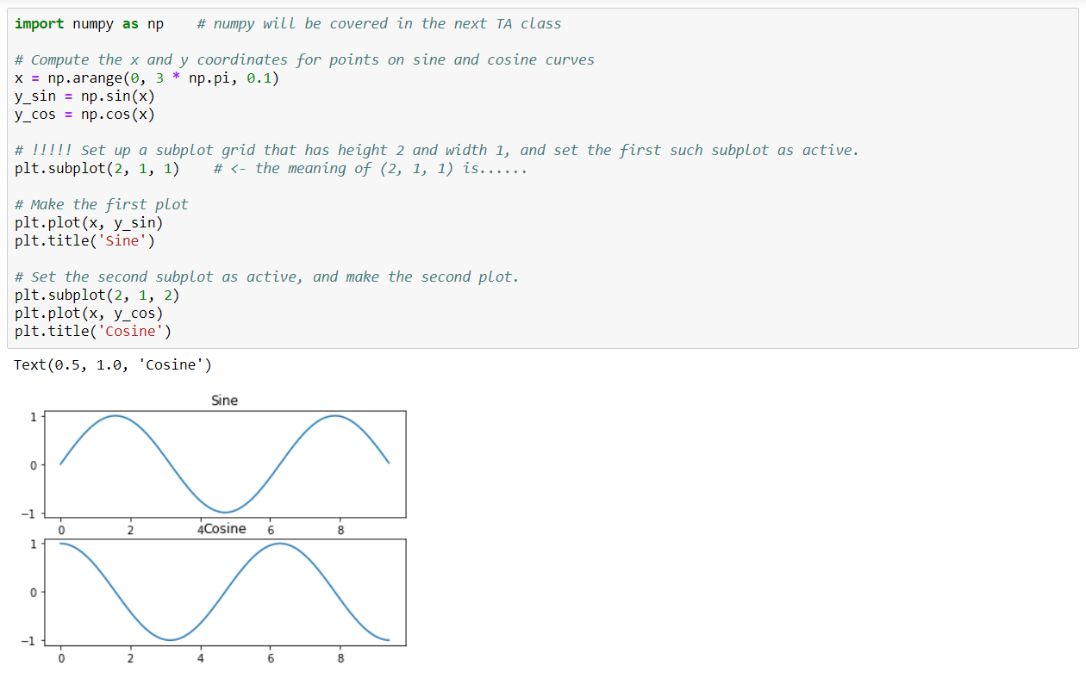
Subplots

Slide 30
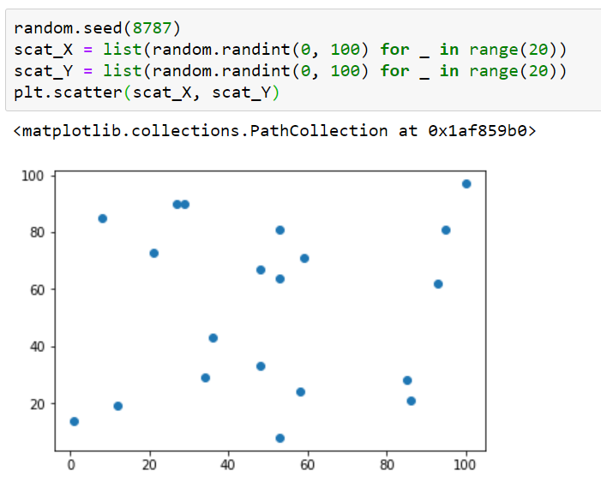
Scatter plot

Slide 31
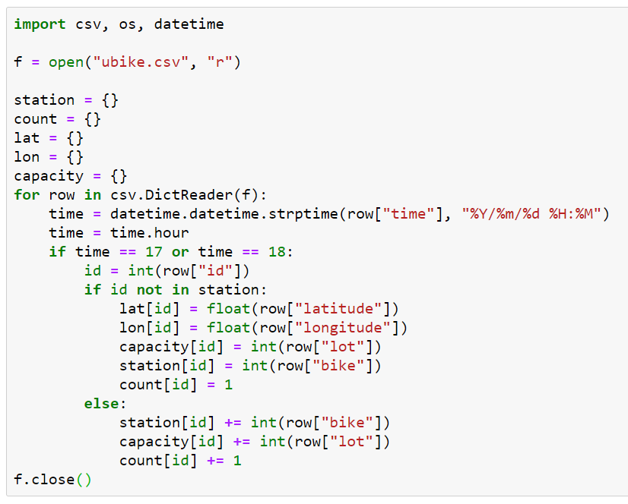
Real world data……

Slide 32
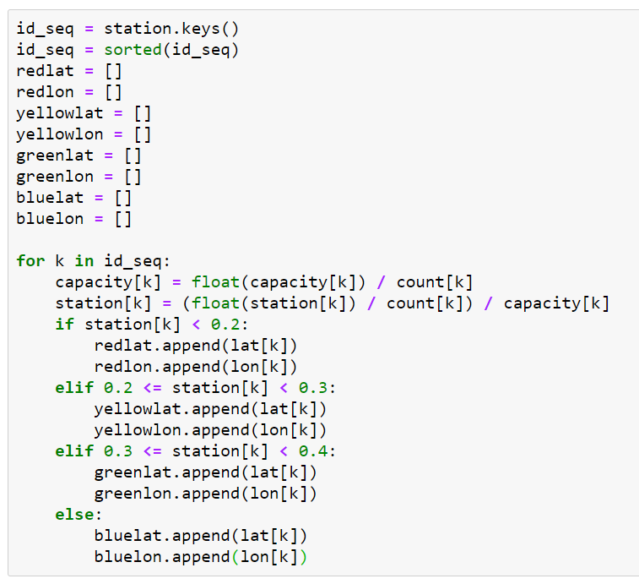

Slide 33
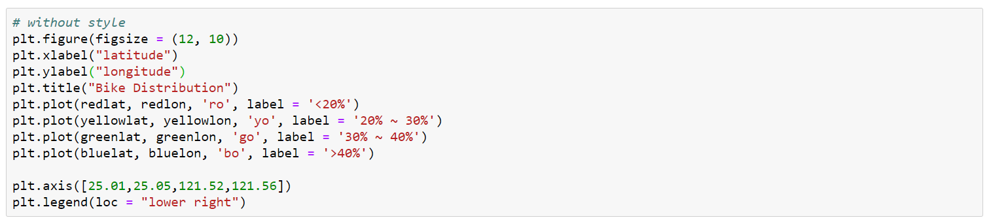
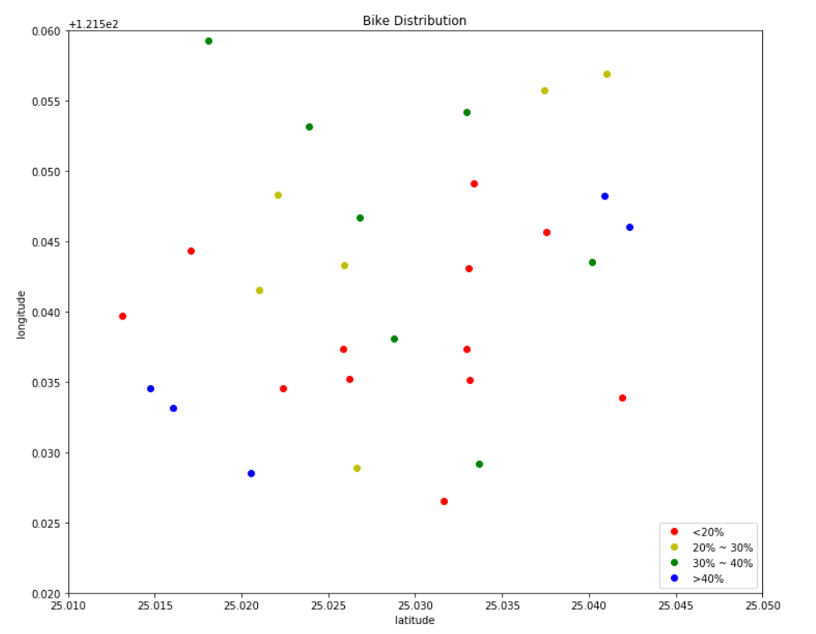

Slide 34
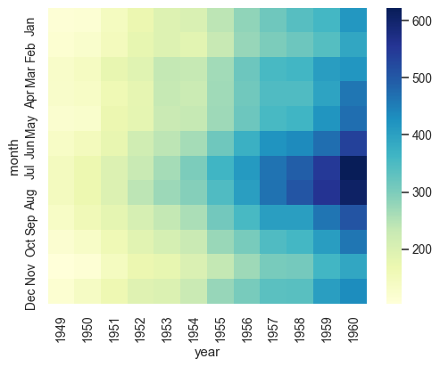
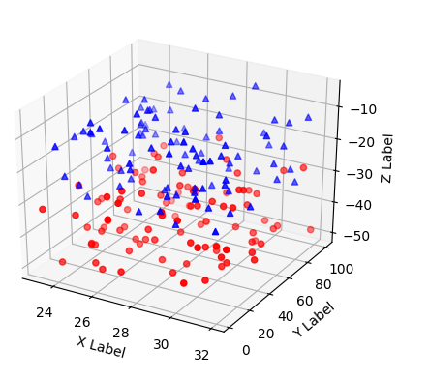
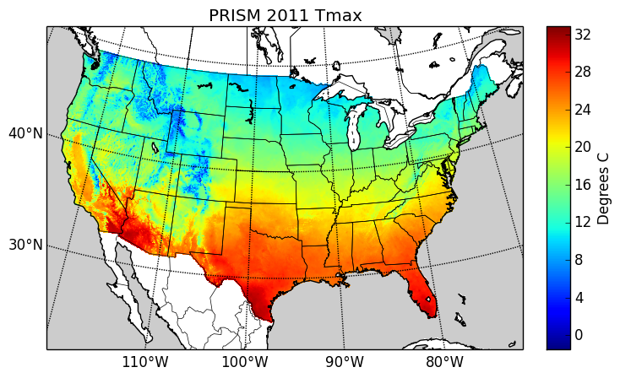
And more…
．mplot3d
．basemap
．Seaborn

Slide 35
For most functions,
you don’t have to build it.
You only need to find it
and learn how to use it.

